Slide 1

Operation Python
4110E223

Slide 2

AGENDA
PYTHON STRINGS
SLICING STRINGS
MODIFY STRINGS
CONCATENATE STRINGS
FORMAT STRINGS
METHOD STRINGS

Slide 3


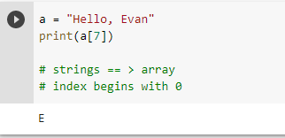
Strings in python are arrays of bytes. Representing Unicode Characters:

Slide 4
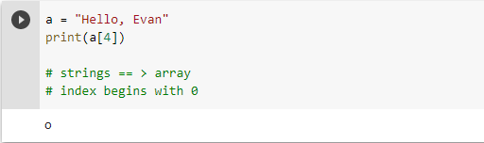
Strings are Arrays ==> access the element of array Python does not have a character data type, a single character is simply a string with a length of 1

Slide 5
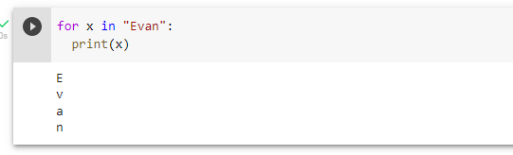
Looping through a String

Slide 6
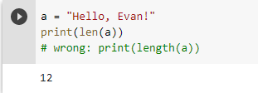
String Length: To get the length of a string use the len () function.

Slide 7
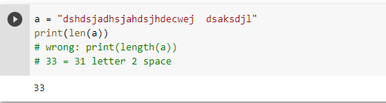
QUIZ: Tell me How many Char appear in “"dshdsjadhsjahdsjhdecwej dsaksdjl”

Slide 8
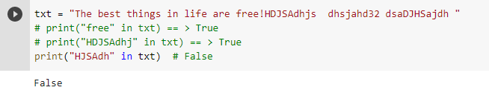
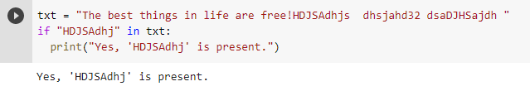

Check String:To check if a certain phrase or character is present in a string, we can use the keyword in.
keyword in vs if
True or False

Slide 9
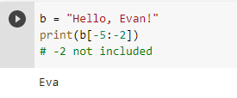
Negative Indexing

Slide 10
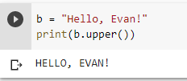

The Upper() method returns the string in upper case:
The lower() method returns the string in lower case:

Slide 11

Remove Whitespace with Strip method
The strip() method removes any whitespace from the beginning or the end

Slide 12

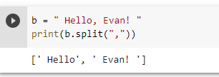

The replace()method replaces a string with another string Separator

Slide 13
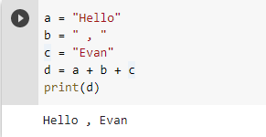
String Concatenation:To concatenate, or combine, two strings you can use the + operator.

Slide 14
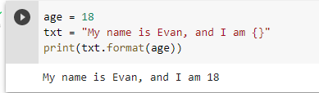
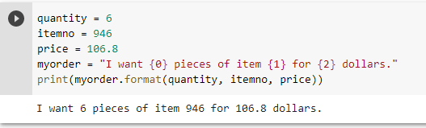
Python - Format - Strings

Slide 15
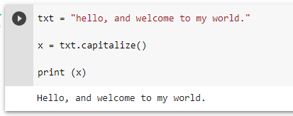
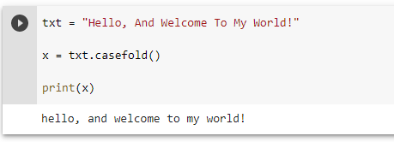
String Methods

Slide 16
THANK YOU
Chinese Name: 蘇伊凡
Student Id: 4110E223
English Name: Evan S. Marquez
Nickname: Suyifann
Email: vnmarqz@gmail.com
Github: https://github.com/4110E223

